Slide 1
Chapter 6: CPU Scheduling

Slide 2
Chapter 6: CPU Scheduling
Basic Concepts
Scheduling Criteria
Scheduling Algorithms
Multiple-Processor Scheduling
Real-Time CPU Scheduling
Operating Systems Examples
Algorithm Evaluation

Slide 3
Objectives
To introduce CPU scheduling, which is the basis for multiprogrammed operating systems
To describe various CPU-scheduling algorithms
To discuss evaluation criteria for selecting a CPU-scheduling algorithm for a particular system
To examine the scheduling algorithms of several operating systems

Slide 4
Basic Concepts
Maximum CPU utilization obtained with multiprogramming
CPU–I/O Burst Cycle – Process execution consists of a cycle of CPU execution and I/O wait
CPU burst followed by I/O burst
CPU burst distribution is of main concern

Slide 5
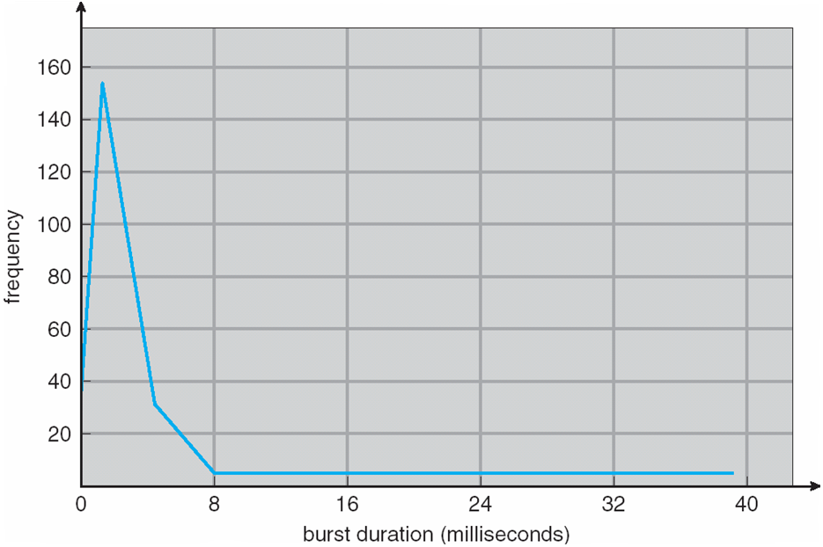
Histogram of CPU-burst Times

Slide 6
CPU Scheduler
Short-term scheduler selects from among the processes in ready queue
CPU scheduling decisions:
1. Running → Waiting
2. Running → Ready
3. Waiting → Ready
Terminates
Scheduling under 1 and 4 is nonpreemptive
All other scheduling is preemptive

Slide 7
Dispatcher
Dispatcher module gives control of the CPU to the process selected by the short-term scheduler; this involves:
switching context
switching to user mode
jumping to the proper location in the user program to restart that program
Dispatch latency – time it takes for the dispatcher to stop one process and start another running

Slide 8
Scheduling Criteria
CPU utilization – keep the CPU as busy as possible
Throughput – # of processes that complete their execution per time unit
Turnaround time – amount of time to execute a particular process
Waiting time – amount of time a process has been waiting in the ready queue
Response time – amount of time it takes from when a request was submitted until the first response is produced, not output (for time-sharing environment)

Slide 9
Scheduling Algorithm Optimization Criteria
Max CPU utilization
Max throughput
Min turnaround time
Min waiting time
Min response time

Slide 10
First-Come, First-Served (FCFS) Scheduling
Process Burst Time
P₁ 24
P₂ 3
P₃ 3
Suppose that the processes arrive in the order: P₁ , P₂ , P₃ The Gantt Chart for the schedule is:
Waiting time for P₁ = 0; P₂ = 24; P₃ = 27
Average waiting time: (0 + 24 + 27)/3 = 17
Notes:
Exam =
Calculate average waiting time
Draw diagram and label

Slide 11
FCFS Scheduling (Cont.)
Suppose that the processes arrive in the order:
P₂ , P₃ , P₁
The Gantt chart for the schedule is:
Waiting time for P₁ = 6; P₂ = 0; P₃ = 3
Average waiting time: (6 + 0 + 3)/3 = 3
Much better than previous case
Convoy effect - short process behind long process
Consider one CPU-bound and many I/O-bound processes

Slide 12
Shortest-Job-First (SJF) Scheduling
Associate with each process the length of its next CPU burst
Use these lengths to schedule the process with the shortest time
SJF is optimal – gives minimum average waiting time for a given set of processes
The difficulty is knowing the length of the next CPU request
Could ask the user

Slide 13
Example of SJF
ProcessArriva l Time Burst Time
P₁ 0.0 6
P₂ 2.0 8
P₃ 4.0 7
P₄ 5.0 3
SJF scheduling chart
Average waiting time = (3 + 16 + 9 + 0) / 4 = 7

Slide 14
Determining Length of Next CPU Burst
Can only estimate the length – should be similar to the previous one
Then pick process with shortest predicted next CPU burst
Can be done by using the length of previous CPU bursts, using exponential averaging
Commonly, α set to ½
Preemptive version called shortest-remaining-time-first

Slide 15
Prediction of the Length of the Next CPU Burst

Slide 16
Examples of Exponential Averaging
α =0
τ_{n+1} = τ_{n}
Recent history does not count
α =1
τ_{n+1} = α t_{n}
Only the actual last CPU burst counts
If we expand the formula, we get:
τ_{n+1} = α t_{n}+(1 - α)α t_{n} ₋₁ + …
+(1 - α )^{j} α t_{n} _{-j} + …
+(1 - α )^{n +1} τ₀
_{e.g.} α = 0.5, τ_{n+1} = 0.5 t_{n}+ 0.25 t_{n-1} + 0.125 t_{n-2} + …
Since both α and (1 - α) are less than or equal to 1, each successive term has less weight than its predecessor

Slide 17
Example of Shortest-remaining-time-first
Now we add the concepts of varying arrival times and preemption to the analysis
ProcessA arri Arrival TimeT Burst Time
P₁ 0 8
P₂ 1 4
P₃ 2 9
P₄ 3 5
Preemptive SJF Gantt Chart
Average waiting time = [(10-1)+(1-1)+(17-2)+5-3)]/4 = 26/4 = 6.5 msec

Slide 18
Priority Scheduling
A priority number (integer) is associated with each process
The CPU is allocated to the process with the highest priority (smallest integer ≡ highest priority)
Preemptive
Nonpreemptive
SJF is priority scheduling where priority is the inverse of predicted next CPU burst time
Problem ≡ Starvation – low priority processes may never execute
Solution ≡ Aging – as time progresses increase the priority of the process

Slide 19
Example of Priority Scheduling
ProcessA arri Burst TimeT Priority
P₁ 10 3
P₂ 1 1
P₃ 2 4
P₄ 1 5
P₅ 5 2
Priority scheduling Gantt Chart
Average waiting time = 8.2 msec
P
P
P
P
P
2
5
1
3
4
0
1
6
1
6
1
8
1
9

Slide 20
Round Robin (RR)
Each process gets a small unit of CPU time (time quantum q), usually 10-100 milliseconds. After this time has elapsed, the process is preempted and added to the end of the ready queue.
If there are n processes in the ready queue and the time quantum is q, then each process gets 1/n of the CPU time in chunks of at most q time units at once. No process waits more than (n-1)q time units.
Timer interrupts every quantum to schedule next process
Performance
q large ⇒ FIFO
q small ⇒ q must be large with respect to context switch, otherwise overhead is too high

Slide 21
Example of RR with Time Quantum = 4
Process Burst Time
P₁ 24
P₂ 3
P₃ 3
The Gantt chart is:
Typically, higher average turnaround than SJF, but better response
q should be large compared to context switch time
q usually 10ms to 100ms, context switch < 10 µs (1 ms = 1000 µs)
Notes:
Good for users
End-user
GUI application

Slide 22
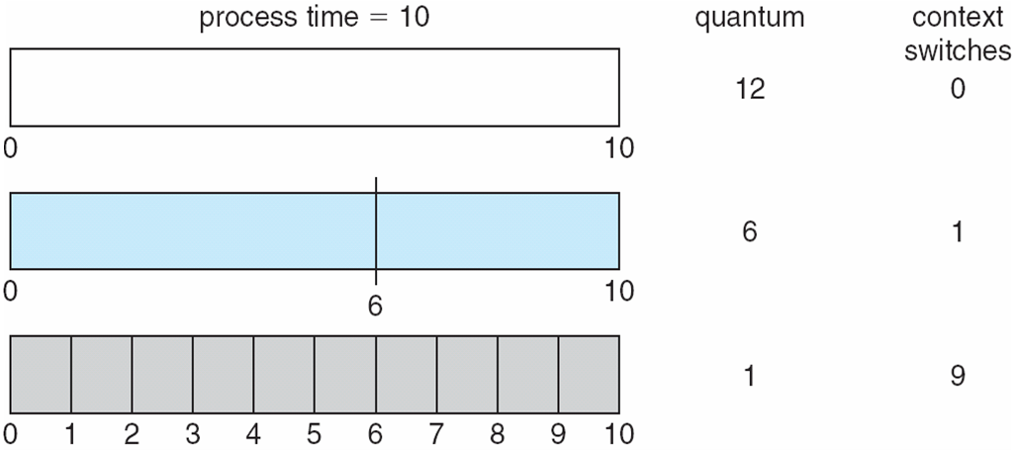
Time Quantum and Context Switch Time

Slide 23
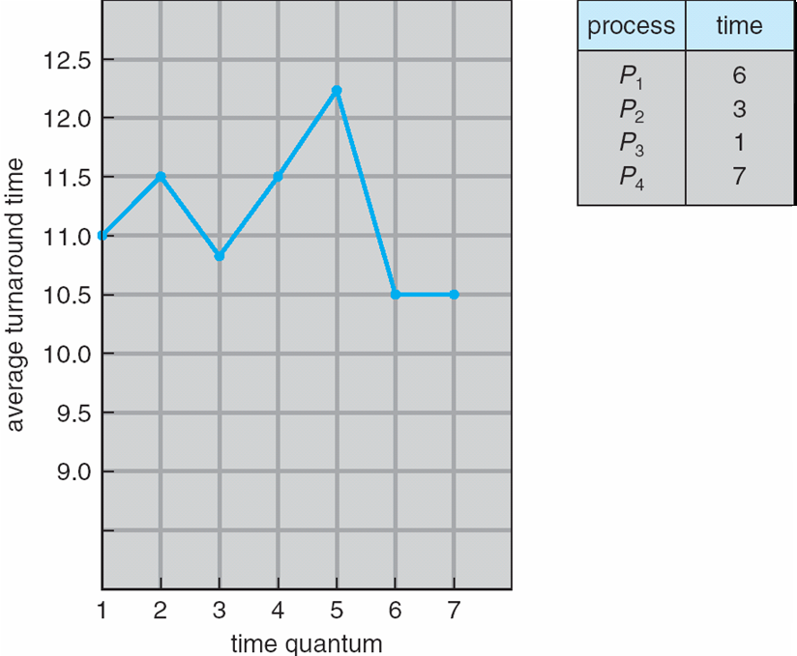
Turnaround Time Varies With The Time Quantum
80% of CPU bursts should be shorter than q

Slide 24
Multilevel Queue
Ready queue is partitioned into separate queues, eg:
foreground (interactive)
background (batch)
Process permanently in a given queue
Each queue has its own scheduling algorithm:
foreground – RR
background – FCFS
Scheduling must be done between the queues:
Fixed priority scheduling; (i.e., serve all from foreground then from background). Possibility of starvation.
Time slice – each queue gets a certain amount of CPU time which it can schedule amongst its processes;
i.e., 80% to foreground in RR
20% to background in FCFS

Slide 25
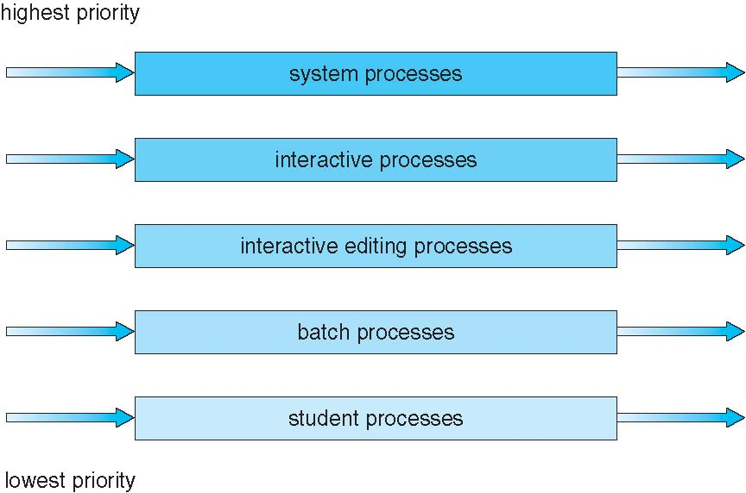
Multilevel Queue Scheduling

Slide 26
Multilevel Feedback Queue
A process can move between the various queues; aging can be implemented this way
Multilevel-feedback-queue scheduler defined by the following parameters:
number of queues
scheduling algorithms for each queue
method used to determine when to upgrade a process
method used to determine when to demote a process
method used to determine which queue a process will enter when that process needs service

Slide 27
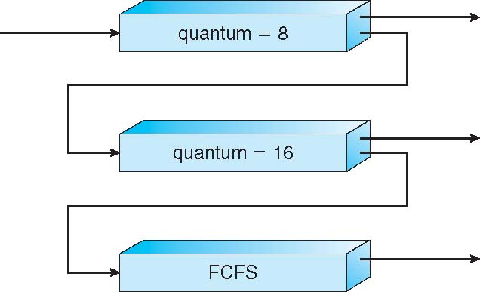
Example of Multilevel Feedback Queue
Three queues:
Q₀ – RR with time quantum 8 milliseconds
Q₁ – RR time quantum 16 milliseconds
Q₂ – FCFS
Scheduling
A new job enters queue Q₀ which is served FCFS
When it gains CPU, job receives 8 milliseconds
If it does not finish in 8 milliseconds, job is moved to queue Q₁
At Q₁ job is again served FCFS and receives 16 additional milliseconds
If it still does not complete, it is preempted and moved to queue Q₂

Slide 28
Multiple-Processor Scheduling
CPU scheduling more complex when multiple CPUs are available
Homogeneous processors within a multiprocessor
Asymmetric multiprocessing – only one processor accesses the system data structures, alleviating the need for data sharing
Symmetric multiprocessing (SMP) – each processor is self-scheduling, all processes in common ready queue, or each has its own private queue of ready processes
Currently, most common
Processor affinity – process has affinity for processor on which it is currently running
soft affinity
hard affinity
Variations including processor sets

Slide 29
NUMA and CPU Scheduling
Non-Uniform Memory Access
Note that memory-placement algorithms can also consider affinity

Slide 30
Multiple-Processor Scheduling – Load Balancing
If SMP, need to keep all CPUs loaded for efficiency
Load balancing attempts to keep workload evenly distributed
Push migration – periodic task checks load on each processor, and if found pushes task from overloaded CPU to other CPUs
Pull migration – idle processors pulls waiting task from busy processor

Slide 31
Multicore Processors
Recent trend to place multiple processor cores on same physical chip
Faster and consumes less power
Multiple threads per core also growing
Takes advantage of memory stall to make progress on another thread while memory retrieve happens

Slide 32
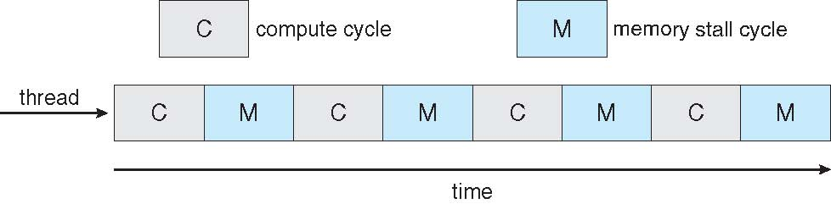

Multithreaded Multicore System

Slide 33
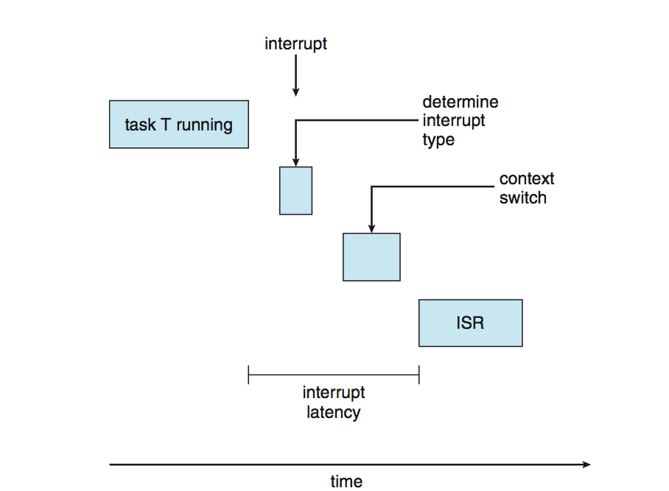
Real-Time CPU Scheduling
Can present obvious challenges
Soft real-time systems – no guarantee as to when critical real-time process will be scheduled
Hard real-time systems – task must be serviced by its deadline
Two types of latencies affect performance
Interrupt latency – time from arrival of interrupt to start of routine that services interrupt
Dispatch latency – time for schedule to take current process off CPU and switch to another

Slide 34
Real-Time CPU Scheduling (Cont.)
Conflict phase of dispatch latency:
Preemption of any process running in kernel mode
Release by low-priority process of resources needed by high-priority processes

Slide 35
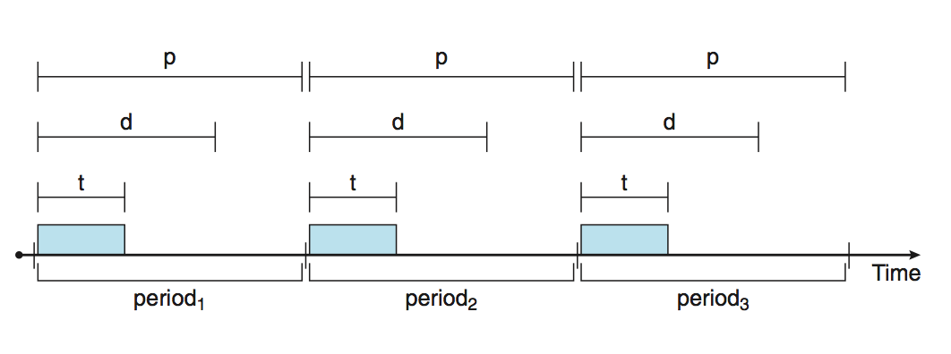
Priority-based Scheduling
For real-time scheduling, scheduler must support preemptive, priority-based scheduling
But only guarantees soft real-time
For hard real-time must also provide ability to meet deadlines
Processes have new characteristics: periodic ones require CPU at constant intervals
Has processing time t, deadline d, period p
0 ≤ t ≤ d ≤ p
Rate of periodic task is 1/p

Slide 36
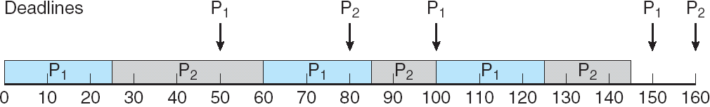
Earliest Deadline First Scheduling (EDF)
Priorities are assigned according to deadlines: the earlier the deadline, the higher the priority;
the later the deadline, the lower the priority
P₁: p=50, d=50, t=25
P₂: p=80, d=80, t=35
P₁,P₂

Slide 37
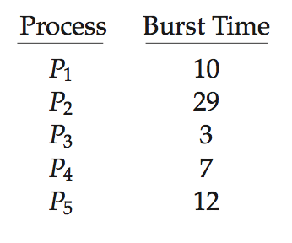
Algorithm Evaluation
How to select CPU-scheduling algorithm for an OS?
Determine criteria, then evaluate algorithms
Deterministic modeling
Type of analytic evaluation
Takes a particular predetermined workload and defines the performance of each algorithm for that workload
Consider 5 processes arriving at time 0:

Slide 38
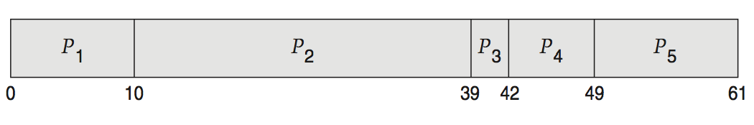
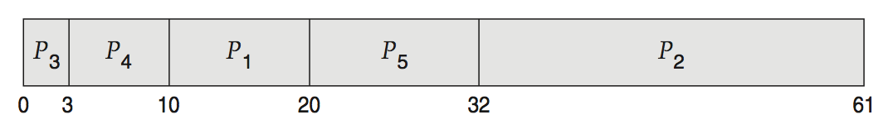
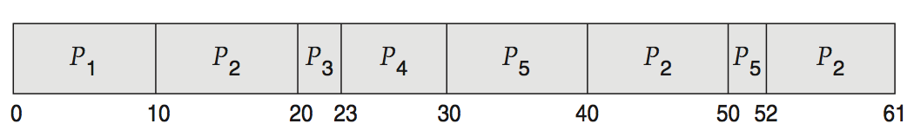
Deterministic Evaluation
For each algorithm, calculate minimum average waiting time
Simple and fast, but requires exact numbers for input, applies only to those inputs
FCFS is 28ms:
Non-preemptive SJF is 13ms:
RR is 23ms:

Slide 39
Simulations
Queueing models limited
Simulations more accurate
Programmed model of computer system
Clock is a variable
Gather statistics indicating algorithm performance
Data to drive simulation gathered via
Random number generator according to probabilities
Distributions defined mathematically or empirically
Trace tapes record sequences of real events in real systems

Slide 40
Evaluation of CPU Schedulers by Simulation

Slide 41
End of Chapter 6

